Slide 1
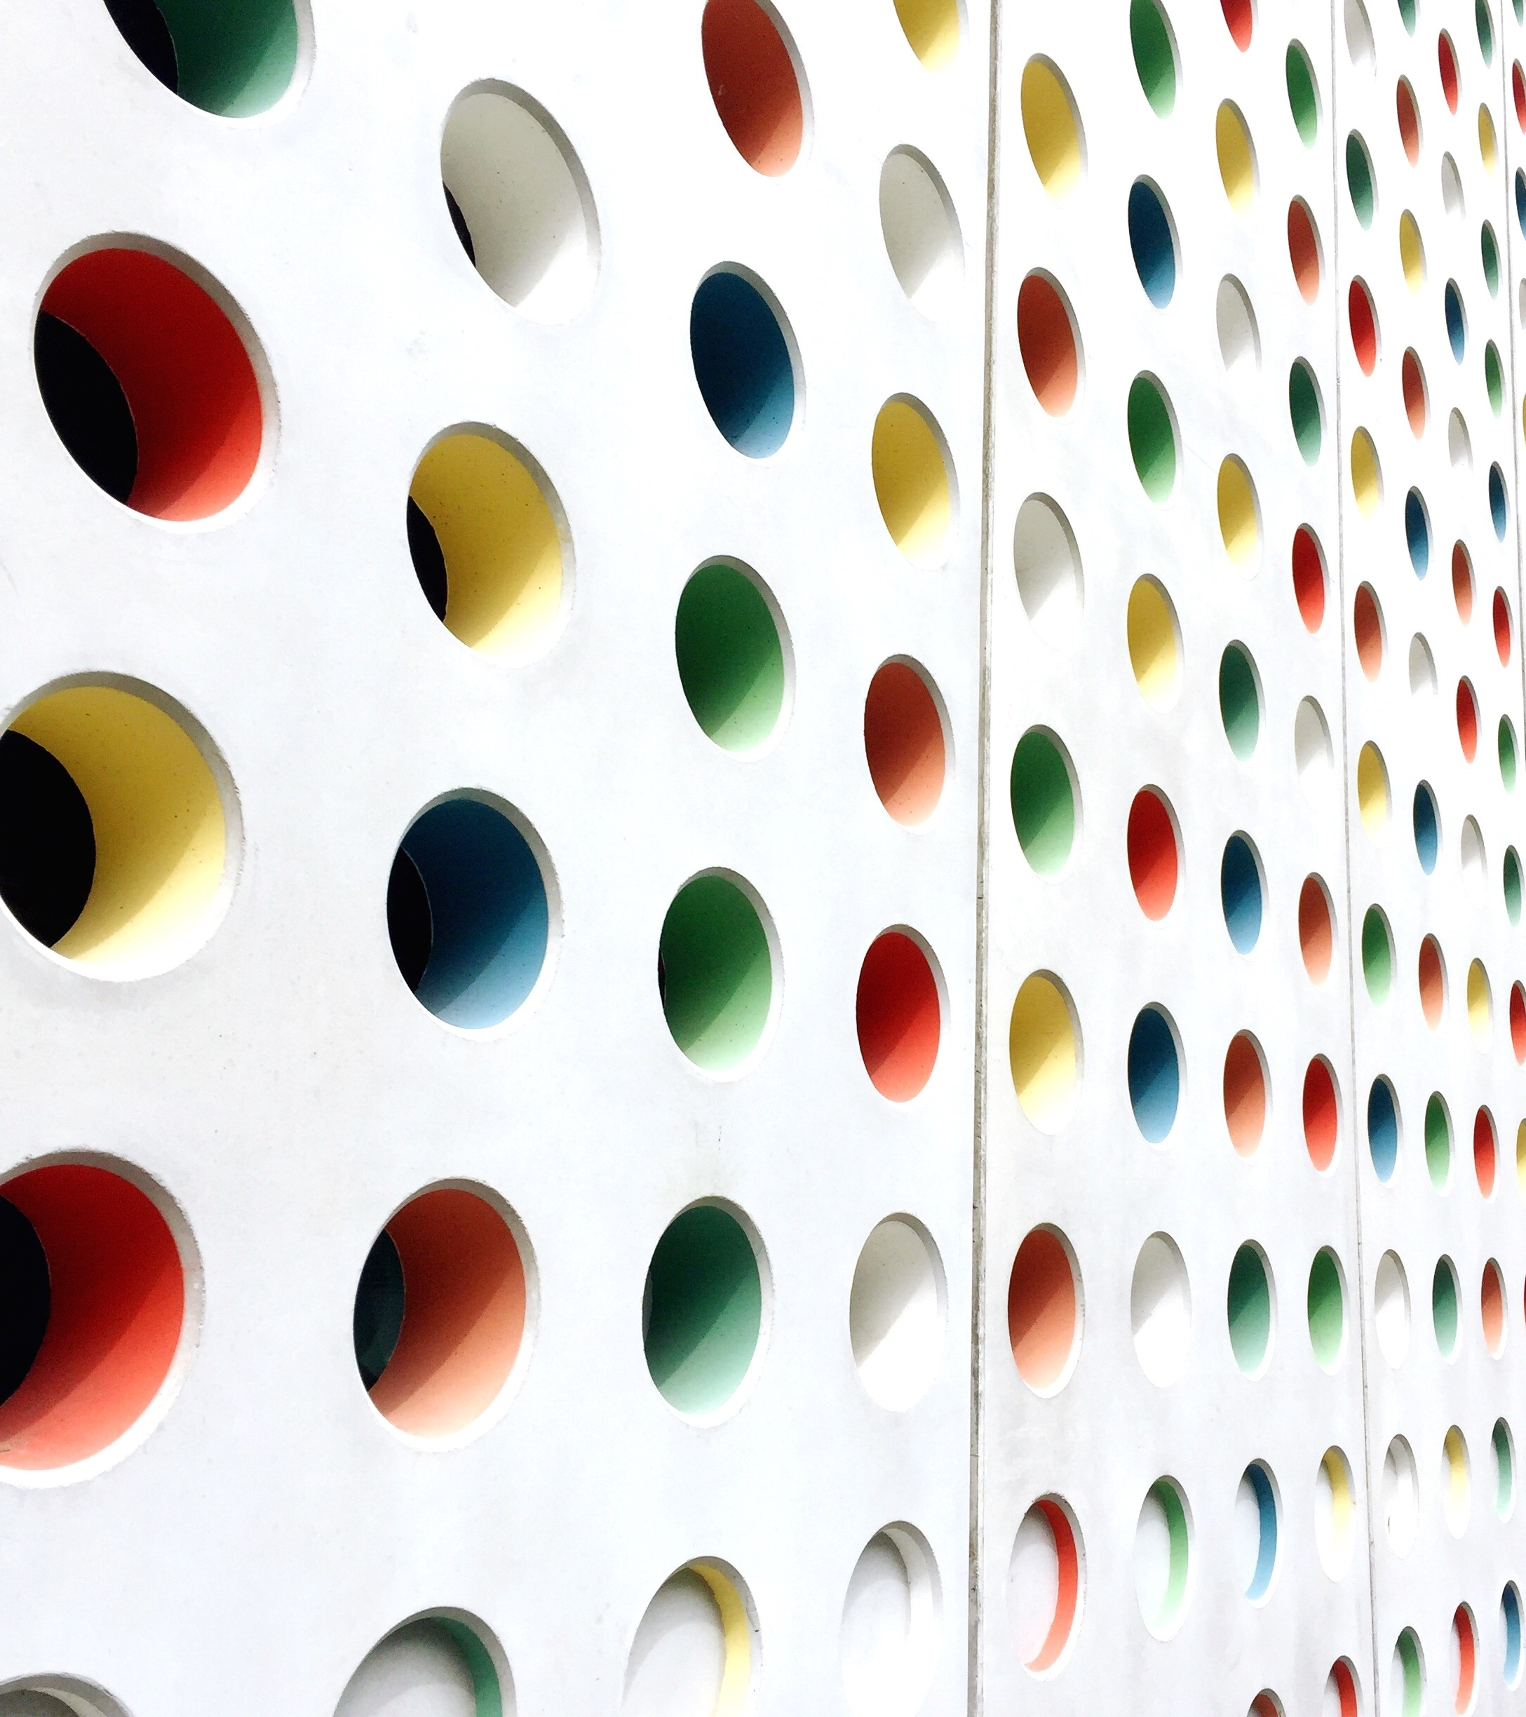
ANHIVR: An Adaptive Neuro-Haptic Interface for Virtual Reality
A Presentation by Gotam Sai Varshith (22BCE1605)

Slide 2
The Challenge: Immersion vs. Precision
Immersion (Hand-Tracking):
✅ Highly natural and intuitive.
❌ Often imprecise, leading to errors and user frustration.
Precision (Controllers):
✅ Reliable, accurate, and provides haptic feedback.
❌ Breaks the sense of presence by introducing a physical tool.

Slide 3
A Window into the User's Mind 🧠
Key Finding:
Research shows that user frustration, or cognitive conflict, can be objectively measured using a non-invasive EEG headset.
The Signal:
This is detected via the Feedback-Related Negativity (FRN), a specific brainwave that appears milliseconds after we recognize an error.
The Opportunity:
If we can detect when a user is struggling, we can build a system that intelligently steps in to help.

Slide 4
The Adaptive Neuro-Haptic Interface for VR
Core Idea:
A smart, closed-loop system that monitors the user's cognitive state and adapts the interaction mode to match their needs.
How it Works:
Default Mode: User interacts naturally with hand-tracking for maximum immersion.
Struggle Detected: The system's EEG sensors detect FRN signals, indicating frustration.
Adaptive Switch: The interface seamlessly transitions to a controller-assisted mode, providing the precision needed to overcome the challenge.
Revert: Once the task is done and frustration subsides, it switches back to hand-tracking.

Slide 5
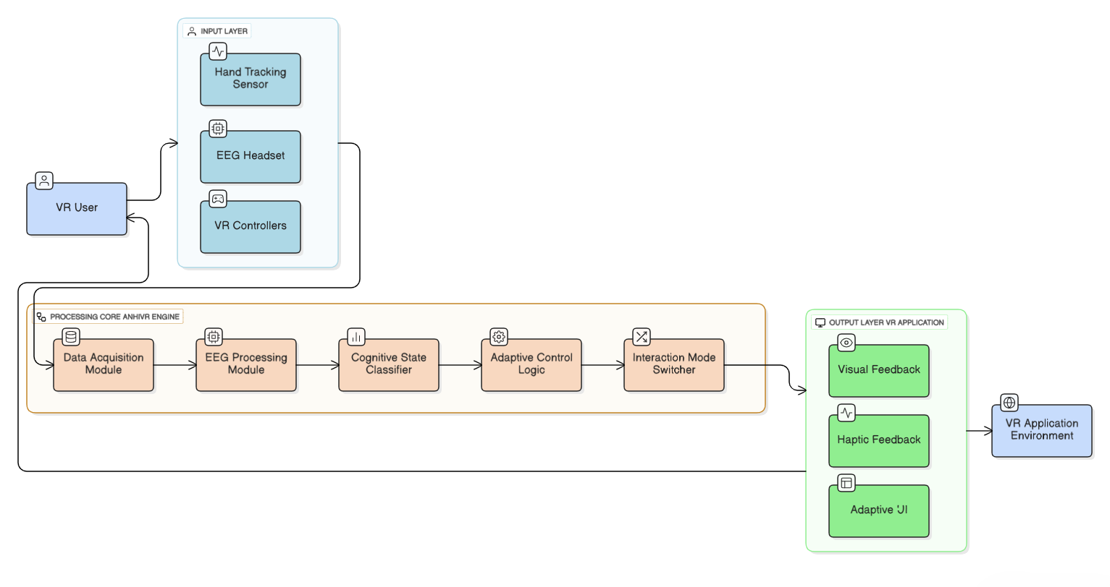
How the ANHIVR System Works

Slide 6
How the ANHIVR System Works
Simple Flow:
Input: Sensors (Hand Tracker, EEG, Controllers) gather data.
Processing: The ANHIVR Engine processes the EEG data, classifies the user's cognitive state, and decides whether to switch modes.
Output: The VR application's UI and interaction mode are updated.

Slide 7
How Will We Know If It Works? 🧪
Methodology: A within-subject user study where participants perform a complex task (e.g., virtual engine assembly) under three different conditions.
The Three Conditions:
Controller-Only (Baseline for Precision)
Hand-Tracking-Only (Baseline for Immersion)
Adaptive ANHIVR (The Proposed System)
Metrics for Success:
Objective: Task completion time, number of errors.
Subjective: User-rated usability (SUS), cognitive load (NASA-TLX), and immersion.

Slide 8
The Best of Both Worlds
Hypothesis: The ANHIVR system will outperform the baseline conditions by combining their strengths.
Error Rate: ANHIVR should be low, similar to Controllers.
Usability Score: ANHIVR should be high.
Immersion Score: ANHIVR should be high, similar to Hand-Tracking.
Condition | Error Rate (Lower is Better) | Immersion Score (Higher is Better) | Usability Score (Higher is Better)
Controller-Only | 🟦 Low | 🟨 Medium | 🟩 Medium
Hand-Tracking-Only | 🟦 High | 🟨 High | 🟩 Low
Adaptive (ANHIVR) | 🟦 Low | 🟨 High | 🟩 High

Slide 9
Conclusion and Next Steps
Contribution:
ANHIVR presents a novel, bio-adaptive approach to HCI in VR, creating interfaces that respond to a user's internal cognitive state.
Future Work:
Integrate other biosensors (e.g., heart rate, eye-tracking) for a more robust picture of user state.
Use machine learning to create personalized profiles that adapt to individual user's brain patterns.
Apply this adaptive concept to other areas like training, accessibility, and rehabilitation.

Slide 10


